Slide 1
Mean Field Methods for Computer and Communication Systems
Jean-Yves Le Boudec
EPFL
Network Science Workshop
Hong Kong
25-27 July 2012

Slide 2
Contents
Mean Field Interaction Model
Convergence to ODE
Finite Horizon: Fast Simulation and Decoupling assumption
Infinite Horizon: Fixed Point Method and Decoupling assumption

Slide 3
Mean Field Interaction Model
1

Slide 4
Mean Field
A model introduced in Physics
interaction between particles is via distribution of states of all particle
An approximation method for a large collection of particles
assumes independence in the master equation
Why do we care in information and communication systems ?
Model interaction of many objects:
Distributed systems, communication protocols, game theory, self-organized systems

Slide 5
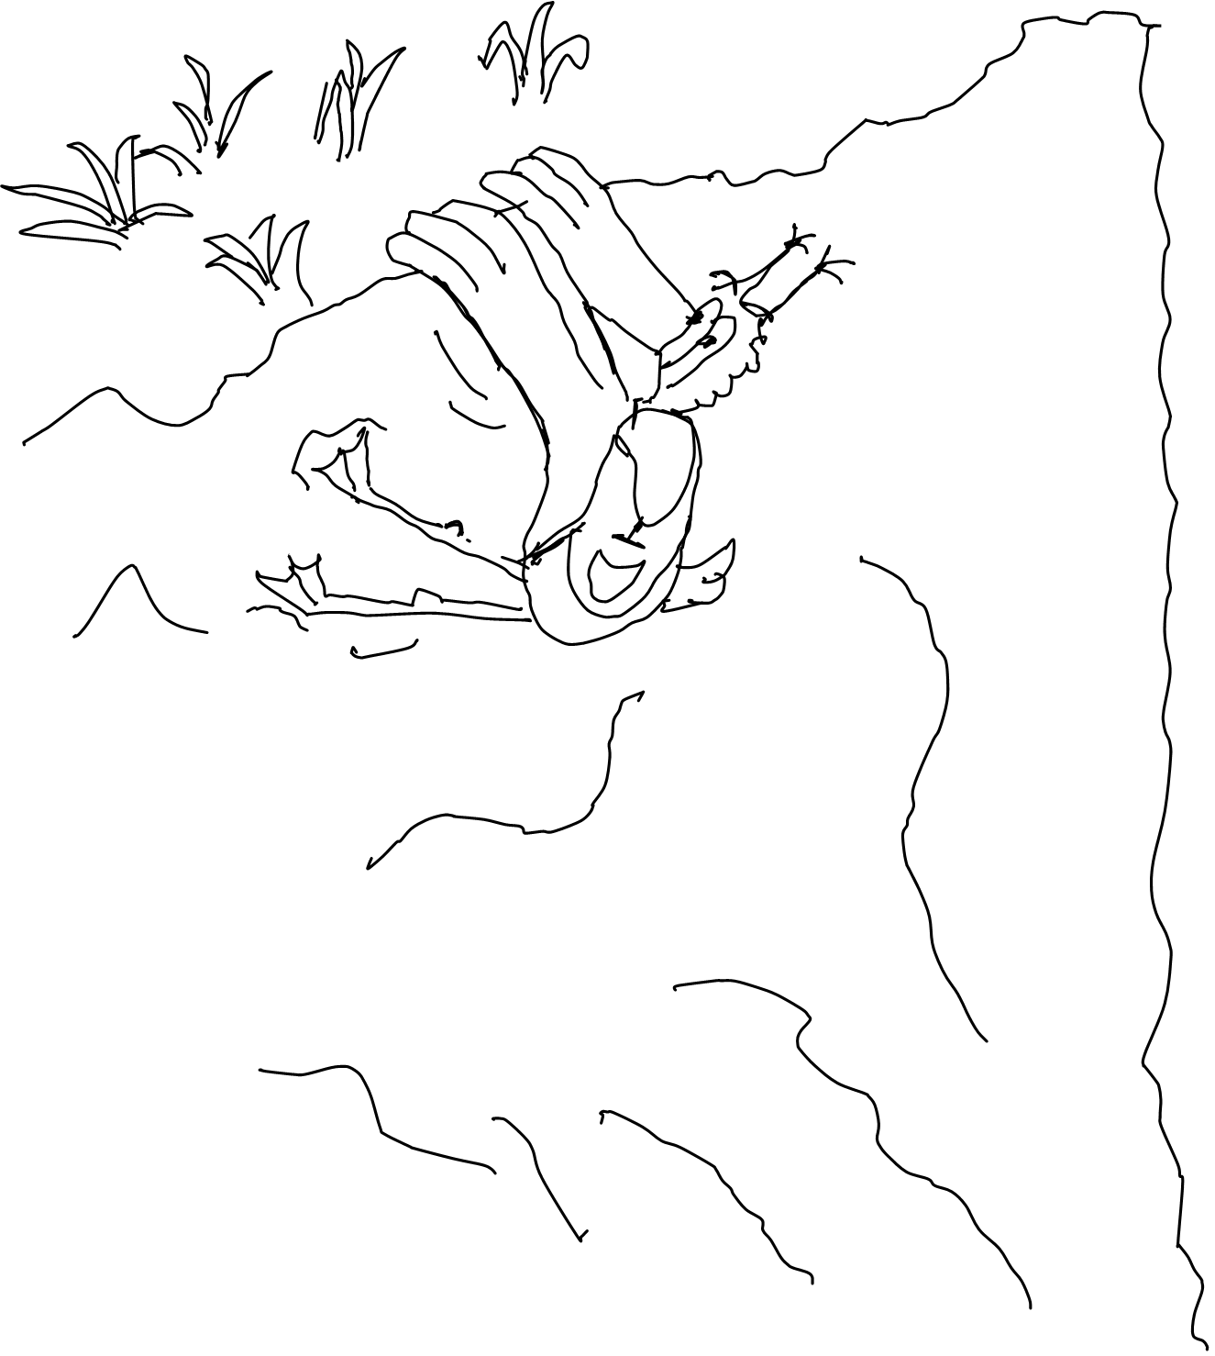
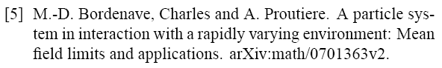
A Few Examples Where Applied
Never again !
E.L.

Slide 6
Mean Field Interaction Model
Time is discrete (this talk) or continuous
N objects, N large
Object n has state X_{n}(t)
(X^{N}₁(t), …, X^{N}_{N}(t)) is Markov
Objects are observable only through their state
“Occupancy measure” M^{N}(t) = distribution of object states at time t

Slide 7
Example: 2-Step Malware
Mobile nodes are either
`S’ Susceptible
`D’ Dormant
`A’ Active
Time is discrete
Transitions affect 1 or 2 nodes
State space is finite = {`S’ , `A’ ,`D’}
Occupancy measure is M(t) = (S(t), D(t), A(t)) with S(t)+ D(t) + A(t) =1
S(t) = proportion of nodes in state `S’ [Benaïm and Le Boudec(2008)]
Recovery
D -> S
Mutual upgrade
D + D -> A + A
Infection by active
D + A -> A + A
Recovery
A -> S
Recruitment by Dormant
S + D -> D + D
Direct infection
S -> D
Direct infection
S -> A

Slide 8
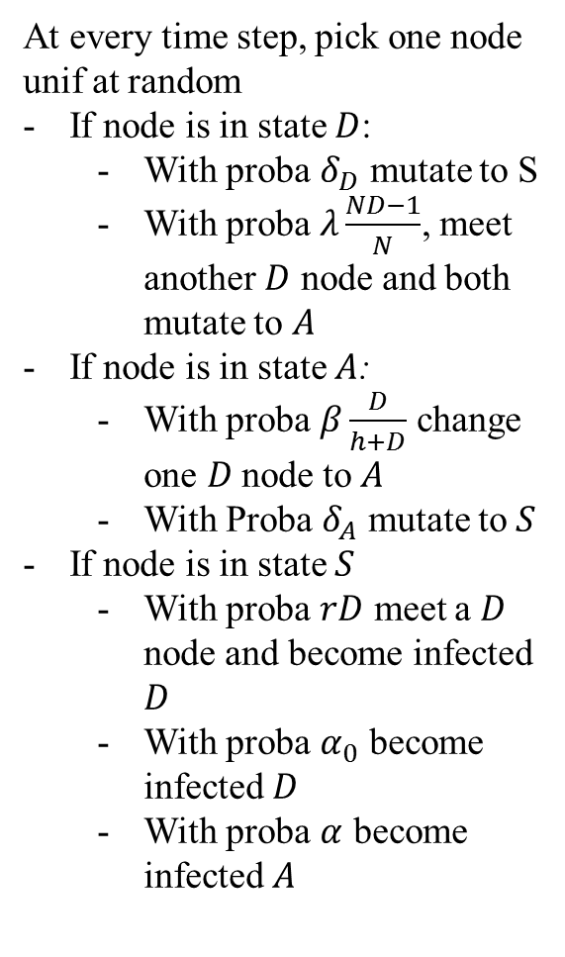
2-Step Malware – Full Specification
At every time step, pick one node unif at random
If node is in state $D$:
With proba $δ_{D}$ mutate to S
With proba $λ\frac{ND−1}{N}$, meet another $D$ node and both mutate to $A$
If node is in state $A$:
With proba $β\frac{D}{h+D}$ change one $D$node to $A$
With Proba $δ_{A}$ mutate to $S$
If node is in state $S$
With proba $rD$ meet a $D$ node and become infected $D$
With proba $α_{0}$ become infected $D$
With proba $α$ become infected $A$
Recovery
D -> S
Mutual upgrade
D + D -> A + A
Infection by active
D + A -> A + A
Recovery
A -> S
Recruitment by Dormant
S + D -> D + D
Direct infection
S -> D
Direct infection
S -> A

Slide 9
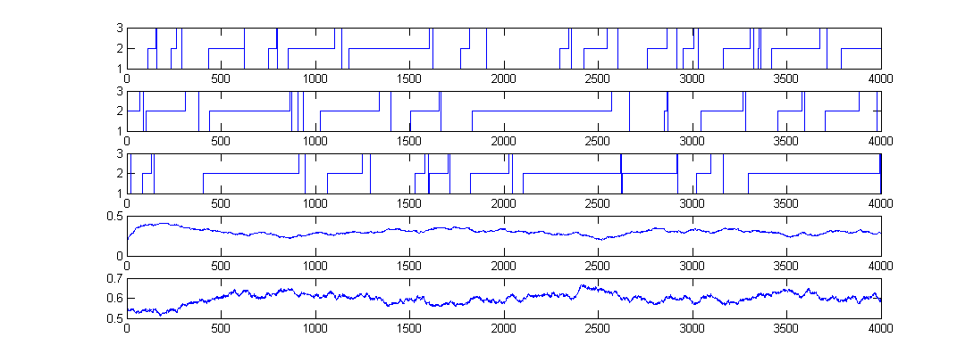
Simulation Runs, N=1000 nodes
Node 1
State = D
State = A
State = S
Node 2
Node 3
D(t)
Proportion of nodes
In state i=1
A(t)
Proportion of nodes
In state i=2

Slide 10
Sample Runs with N = 1000

Slide 11
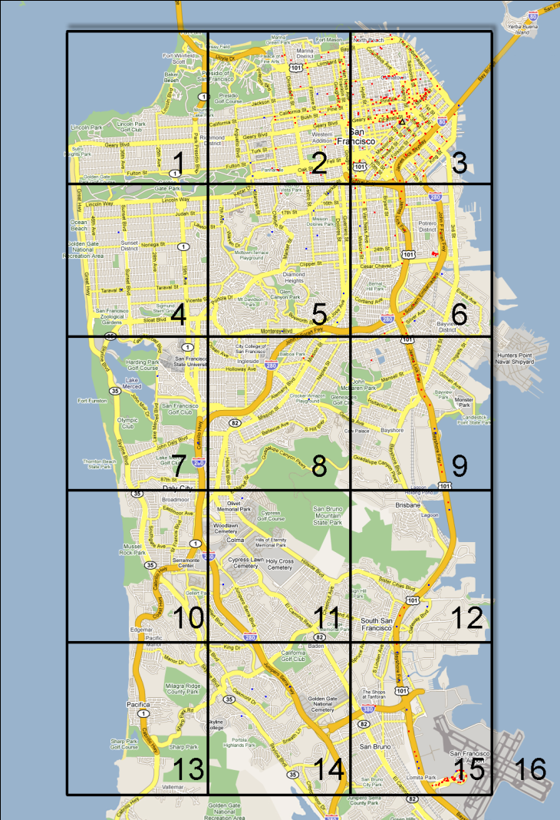
The Importance of Being Spatial
Mobile node state = (c, t) c = 1 … 16 (position)
t ∊ R⁺ (age of gossip)
Time is continuous
Occupancy measure is F_{c}(z,t) = proportion of nodes that at location c and have age ≤ z [Age of Gossip, Chaintreau et al.(2009)]
no class 16 classes
Qqplots simulation vs mean field

Slide 12
What can we do with a Mean Field Interaction Model ?
Large N asymptotics, Finite Horizon
fluid limit of occupancy measure (ODE)
decoupling assumption
(fast simulation)
Issues
When valid
How to formulate the fluid limit
Large t asymptotic
Stationary approximation of occupancy measure
Decoupling assumption
Issues
When valid

Slide 13
Convergence to ode
E. L.
2.

Slide 14
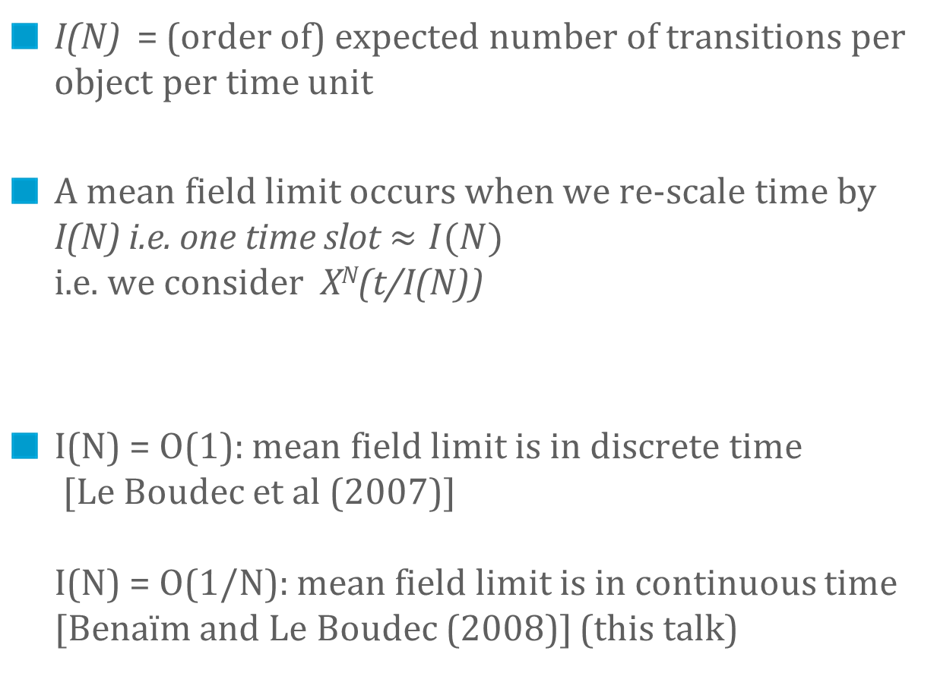
To Obtain a Mean Field Limit we Must Make Assumptions about the Intensity I(N)
I(N) = (order of) expected number of transitions per object per time unit
A mean field limit occurs when we re-scale time by I(N) i.e. one time slot $≈I(N)$ i.e. we consider X^{N}(t/I(N))
I(N) = O(1): mean field limit is in discrete time [Le Boudec et al (2007)] I(N) = O(1/N): mean field limit is in continuous time [Benaïm and Le Boudec (2008)] (this talk)

Slide 15
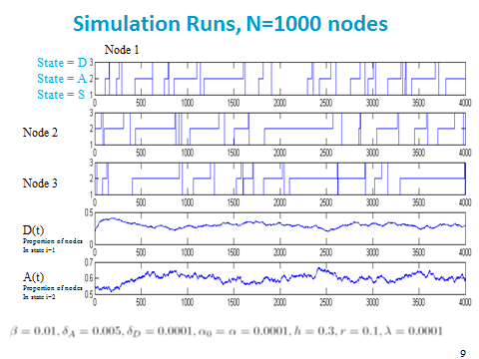

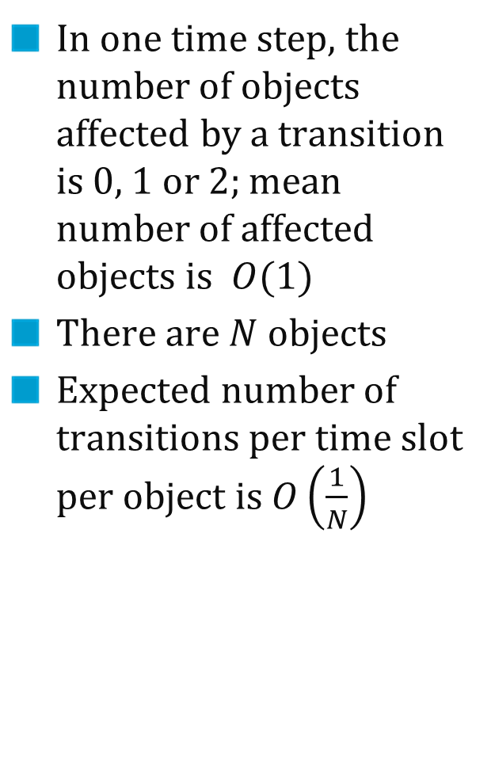
Intensity for this model is $1/N$
In one time step, the number of objects affected by a transition is 0, 1 or 2; mean number of affected objects is $O(1)$
There are $N$ $objects$
Expected number of transitions per time slot per object is $O\left(\frac{1}{N}\right)$

Slide 16
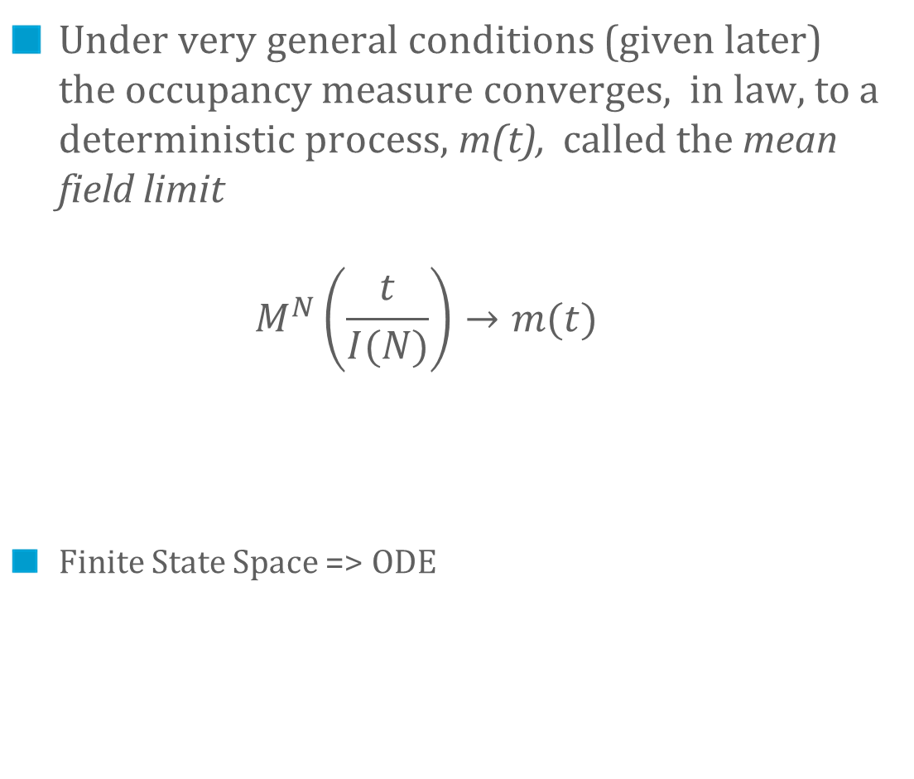
The Mean Field Limit
Under very general conditions (given later) the occupancy measure converges, in law, to a deterministic process, m(t), called the mean field limit $M^{N}\left(\frac{t}{I(N)}\right)→m(t)$
Finite State Space => ODE

Slide 17
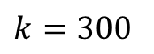
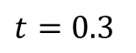
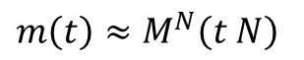
Mean Field Limit
N = +∞
$$t=0.3$$
$$m\left(t\right)≈M^{N}\left(t N\right)$$
Stochastic
system
N = 1000
$$k=300$$

Slide 18
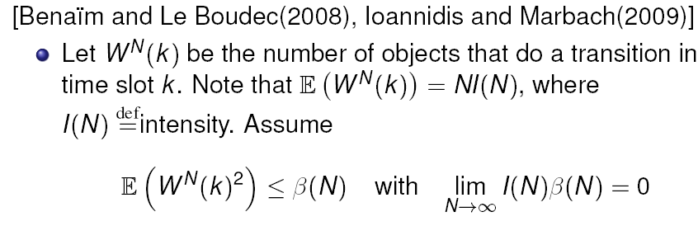
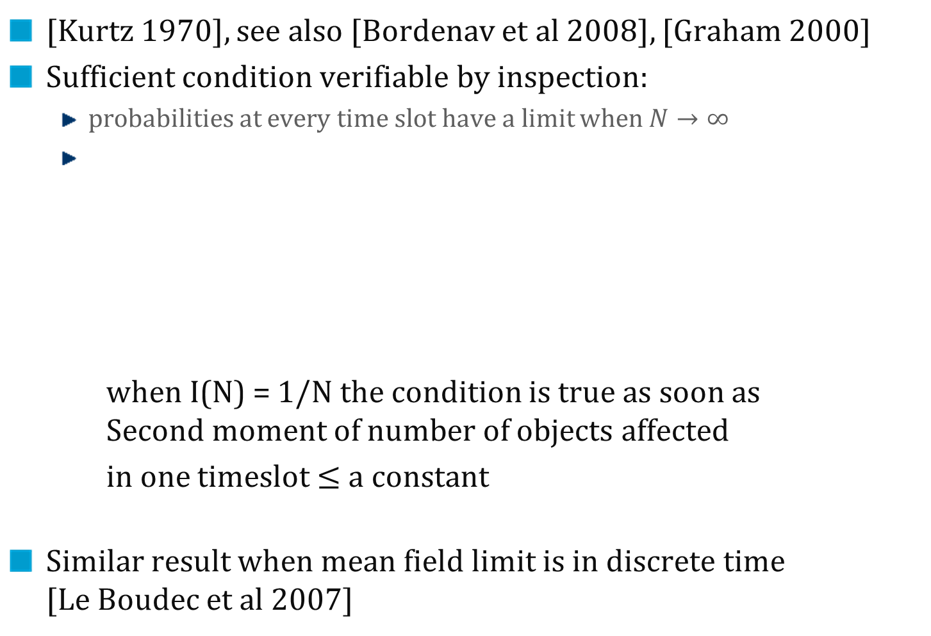
Sufficient Conditions for Convergence
[Kurtz 1970], see also [Bordenav et al 2008], [Graham 2000]
Sufficient condition verifiable by inspection:
probabilities at every time slot have a limit when $N→∞$
when I(N) = 1/N the condition is true as soon as Second moment of number of objects affected
in one timeslot $≤$ $a constant$
Similar result when mean field limit is in discrete time [Le Boudec et al 2007]

Slide 19
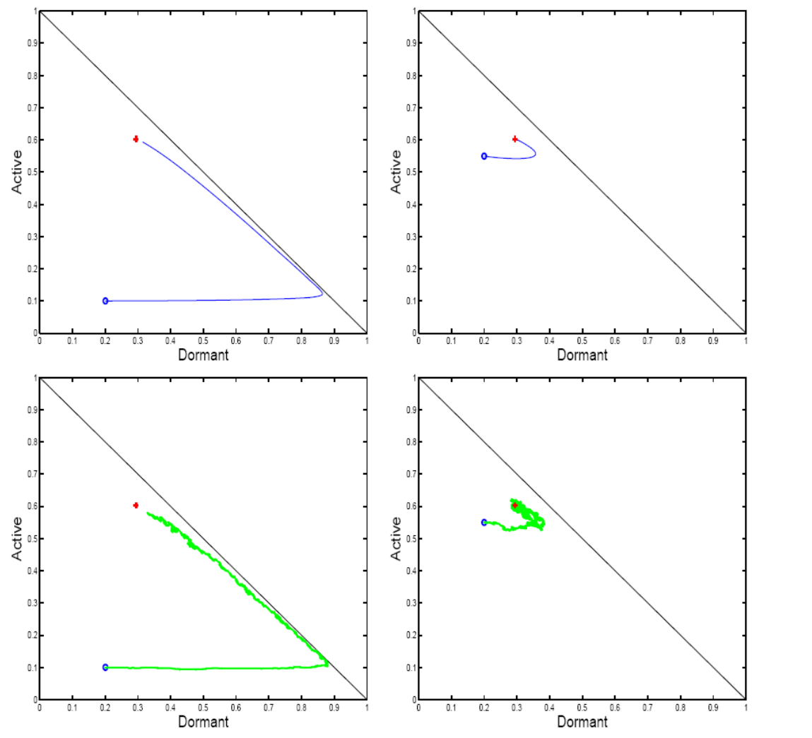
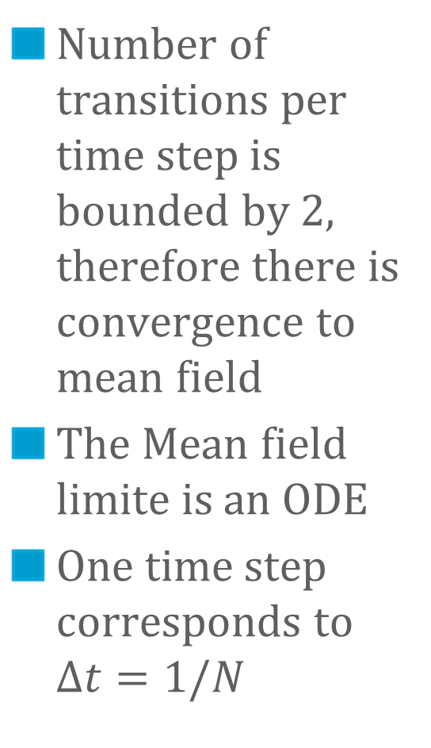
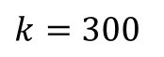
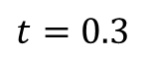
Example: Convergence to Mean Field
Number of transitions per time step is bounded by 2, therefore there is convergence to mean field
The Mean field limite is an ODE
One time step corresponds to $Δt=1/N$
Mean Field Limit
N = +∞
$$t=0.3$$
Stochastic
system
N = 1000
$$k=300$$

Slide 20
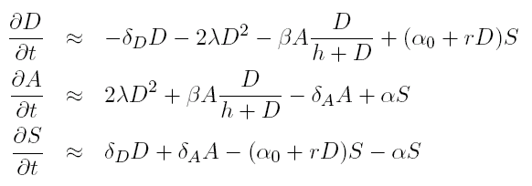
Formulating the Mean Field Limit
Drift = sum over all transitions of proba of transition x Delta to system state M^{N}(t)
Re-scale drift by intensity
Equation for mean field limit is
dm/dt = limit of rescaled drift
Can be automated http://icawww1.epfl.ch/IS/tsed
drift =
ODE
=
=
=

Slide 21
Convergence to Mean Field
For the general state space, things may be more complex (fluid limit is not an ODE, e.g. [Chaintreau et al, 2009], [Gomez-Serrano et al, 2012])
E. L.
Thus:
For the finite state space case, most cases are verifiable by inspection of the model
E.L.

Slide 22
FINITE HORIZON : Fast Simulation and Decoupling assumption
3.

Slide 23
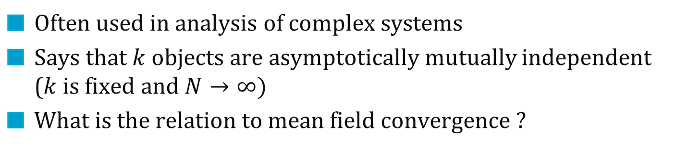
The Decoupling Assumption
Often used in analysis of complex systems
Says that $k$objects are asymptotically mutually independent ($k$ is fixed and $N→∞)$
What is the relation to mean field convergence ?

Slide 24
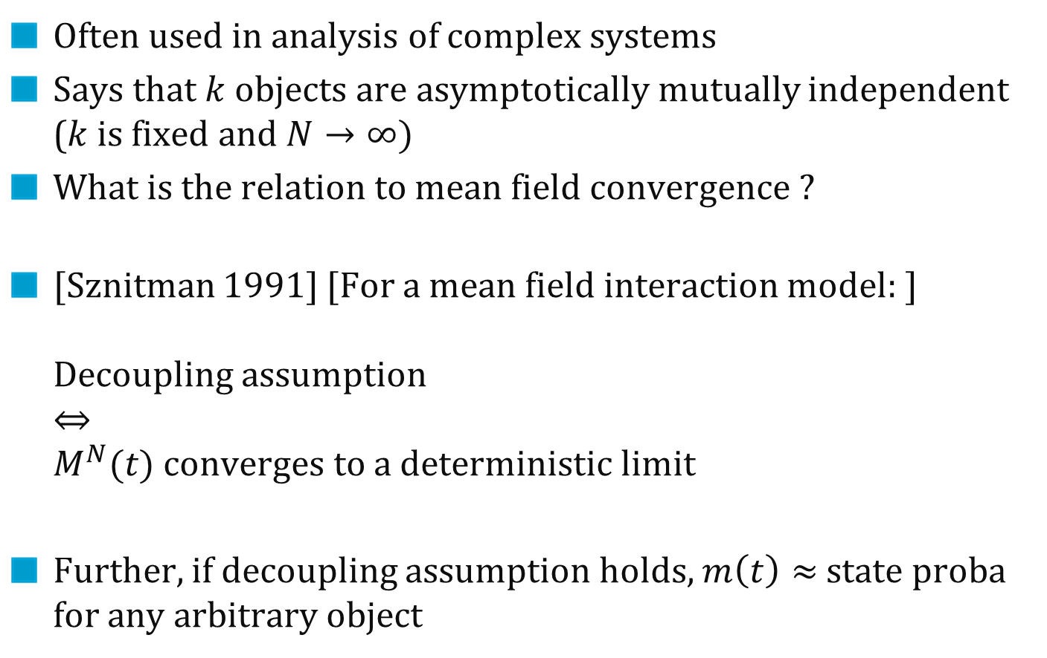
The Decoupling Assumption
Often used in analysis of complex systems
Says that $k$objects are asymptotically mutually independent ($k$ is fixed and $N→∞)$
What is the relation to mean field convergence ?
[Sznitman 1991] [For a mean field interaction model: ] Decoupling assumption $⇔$ $M^{N}(t)$ converges to a deterministic limit
Further, if decoupling assumption holds, $m\left(t\right)≈$ state proba for any arbitrary object

Slide 25
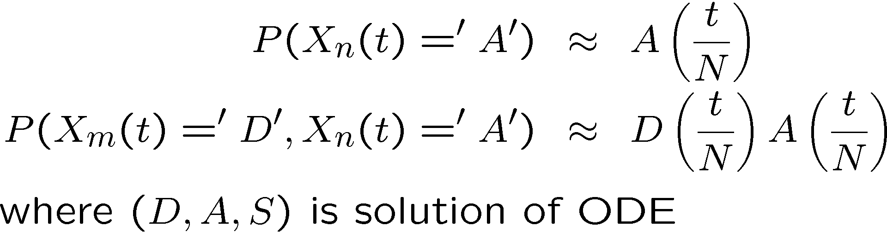
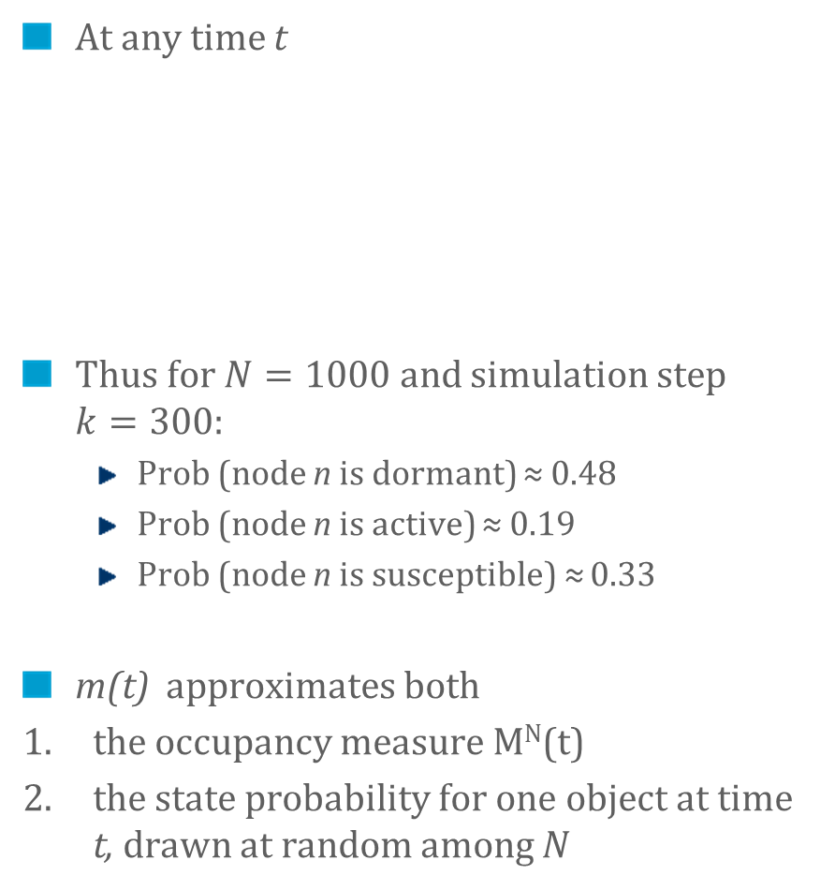
The Two Interpretations of the Mean Field Limit
At any time t
Thus for $N=1000$ and simulation step $k=300$:
Prob (node n is dormant) ≈ 0.48
Prob (node n is active) ≈ 0.19
Prob (node n is susceptible) ≈ 0.33
m(t) approximates both
the occupancy measure M^{N}(t)
the state probability for one object at time t, drawn at random among N
$$t=0.3$$
$$k=300$$

Slide 26
Fast Simulation
The evolution for one object as if the other objects had a state drawn randomly and independently from the distribution m(t)
Is valid over finite horizon whenever mean field convergence occurs
Can be used to perform «fast simulation», i.e., simulate in detail only one or two objects, replace the rest by the mean field limit (ODE)

Slide 27
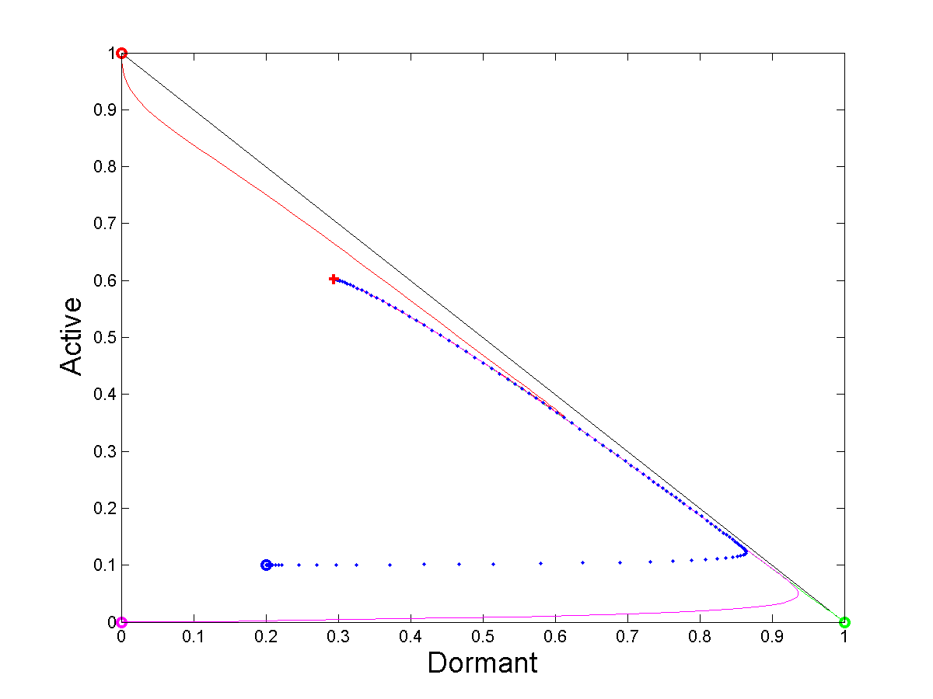
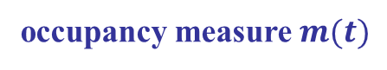
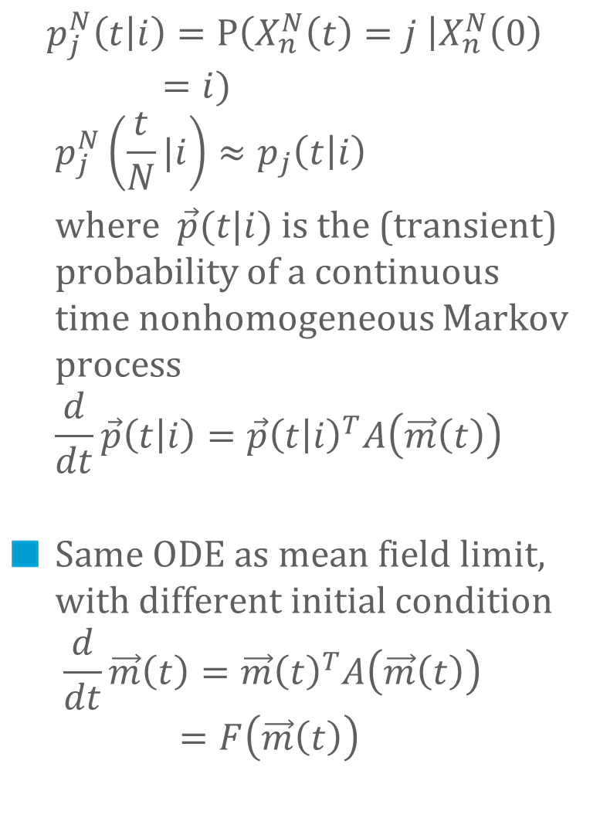
We can fast-simulate one node, and even compute its PDF at any time
$$p_{j}^{N}\left(t | i\right)=P\left(X_{n}^{N}\left(t\right)=j \right|X_{n}^{N}\left(0\right)=i) \\ p_{j}^{N}\left(\frac{t}{N}|i\right)≈p_{j}\left(t | i\right)$$
where $\vec{p}(t|i)$is the (transient) probability of a continuous time nonhomogeneous Markov process $$\frac{d}{dt}\vec{p}\left(t | i\right)=\vec{p}{\left(t | i\right)}^{T}A\left(\vec{m}\left(t\right)\right)$$
Same ODE as mean field limit, with different initial condition $\frac{d}{dt}\vec{m}\left(t\right)=\vec{m}{\left(t\right)}^{T}A\left(\vec{m}\left(t\right)\right)=F\left(\vec{m}\left(t\right)\right)$
pdf of node 2 (initially in A state)
occupancy measure $m(t)$
pdf of node 3
pdf of node 1

Slide 28
Infinite Horizon: Fixed Point Method and Decoupling assumption
4.

Slide 29
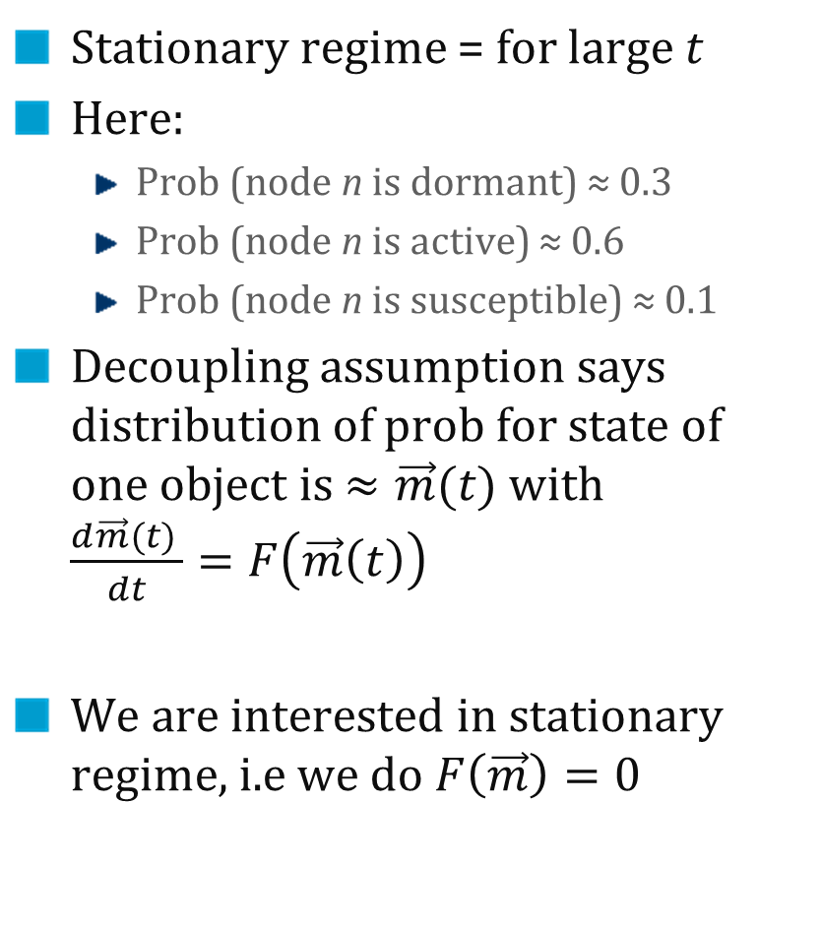
Decoupling Assumption in Stationary Regime
Stationary regime = for large $t$
Here:
Prob (node n is dormant) ≈ 0.3
Prob (node n is active) ≈ 0.6
Prob (node n is susceptible) ≈ 0.1
Decoupling assumption says distribution of prob for state of one object is $≈\vec{m}(t)$ with $\frac{d\vec{m}(t) }{dt}=F\left(\vec{m}\left(t\right)\right)$
We are interested in stationary regime, i.e we do $F\left(\vec{m}\right)=0$

Slide 30
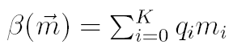
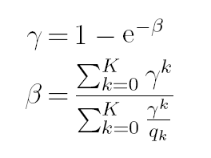
Example: 802.11 Analysis, Bianchi’s Formula
ODE for mean field limit
802.11 single cell
m_{i} = proba one node is in backoff stage I
β= attempt rate
γ = collision proba
See [Benaim and Le Boudec , 2008] for this analysis
Solve for Fixed Point:
Bianchi’s
Fixed
Point
Equation
[Bianchi 1998]

Slide 31
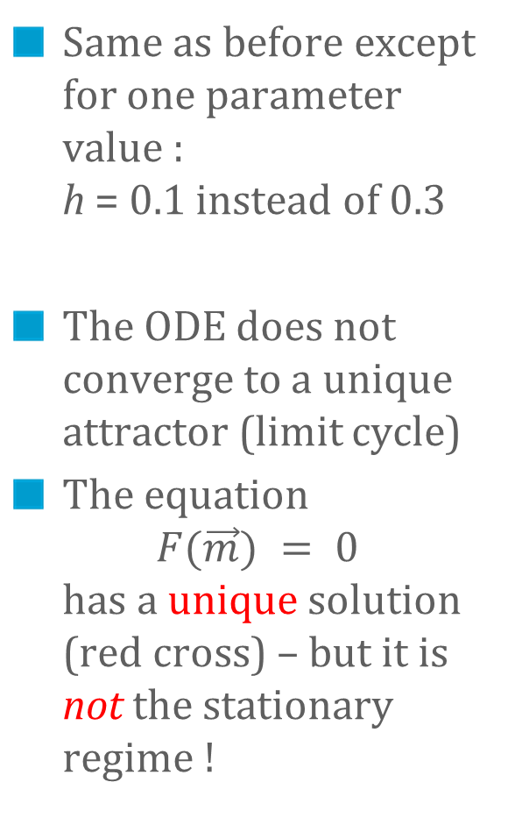
Example Where Fixed Point Method Fails
Same as before except for one parameter value : h = 0.1 instead of 0.3
The ODE does not converge to a unique attractor (limit cycle)
The equation $F(\vec{m}) = 0$ has a unique solution (red cross) – but it is not the stationary regime !

Slide 32
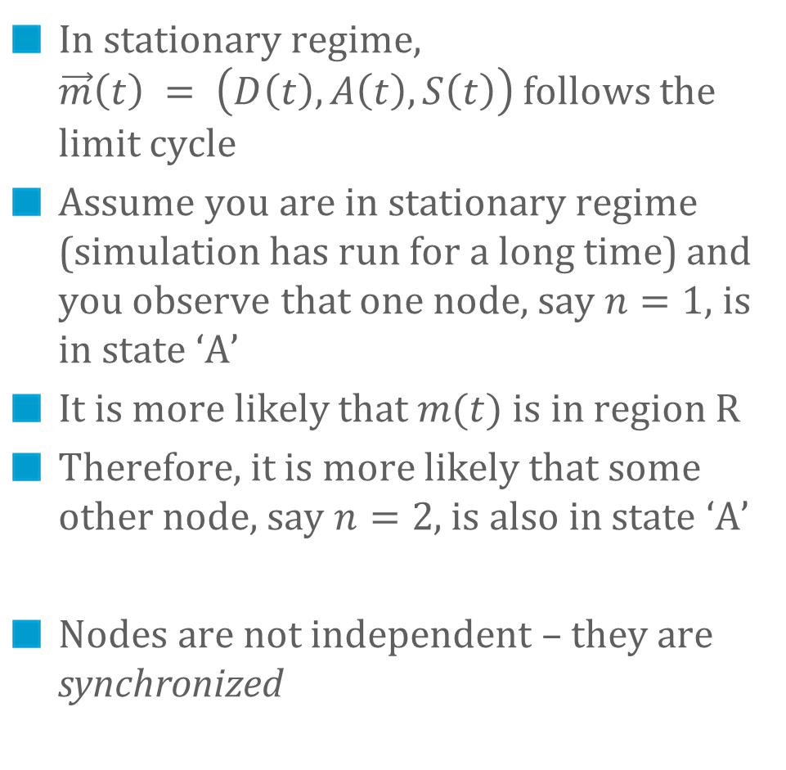
When the Fixed Point Method Fails, Decoupling Assumption Does not Hold
In stationary regime, $\vec{m}\left(t\right) = \left(D\left(t\right), A\left(t\right), S\left(t\right)\right)$follows the limit cycle
Assume you are in stationary regime (simulation has run for a long time) and you observe that one node, say $n=1$, is in state ‘A’
It is more likely that $m(t)$ is in region R
Therefore, it is more likely that some other node, say $n=2$, is also in state ‘A’
Nodes are not independent – they are synchronized
R
h=0.1

Slide 33
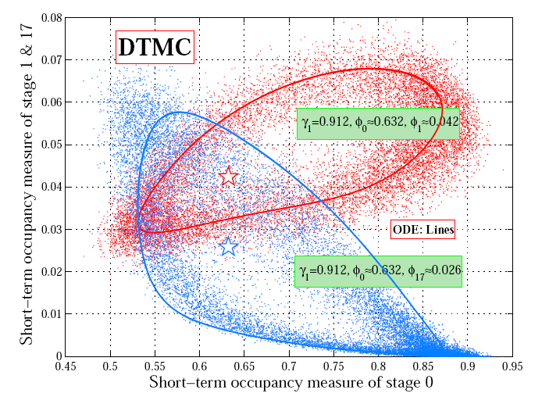
Example: 802.11 with Heterogeneous Nodes
[Cho et al, 2010] Two classes of nodes with heterogeneous parameters (restransmission probability) Fixed point equation has a unique solution, but this is not the stationary proba There is a limit cycle

Slide 34
Where is the Catch ?
Decoupling assumption says that nodes m and n are asymptotically independent
There is mean field convergence for this example
But we saw that nodes may not be asymptotically independent
… is there a contradiction ?

Slide 35
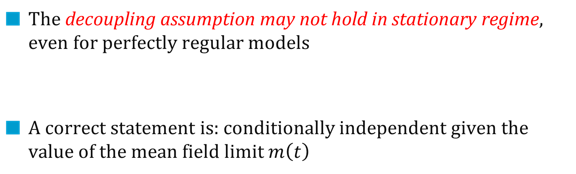
Markov chain is ergodic
Mean Field
Convergence
m_{i}(t) m_{j}(t)
≠
m_{i}(t) m_{j}(t)
The decoupling assumption may not hold in stationary regime, even for perfectly regular models
A correct statement is: conditionally independent given the value of the mean field limit $m\left(t\right)$

Slide 36
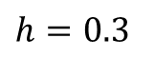
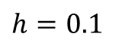
Positive Result 1 [e.g. Benaim et al 2008] : Decoupling Assumption Holds in Stationary Regime if mean field limit ODE has a unique fixed point to which all trajectories converge
Decoupling does not hold in stationary regime
Decoupling holds in stationary regime
$$h=0.1$$
$$h=0.3$$

Slide 37
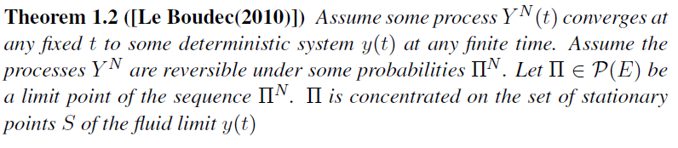
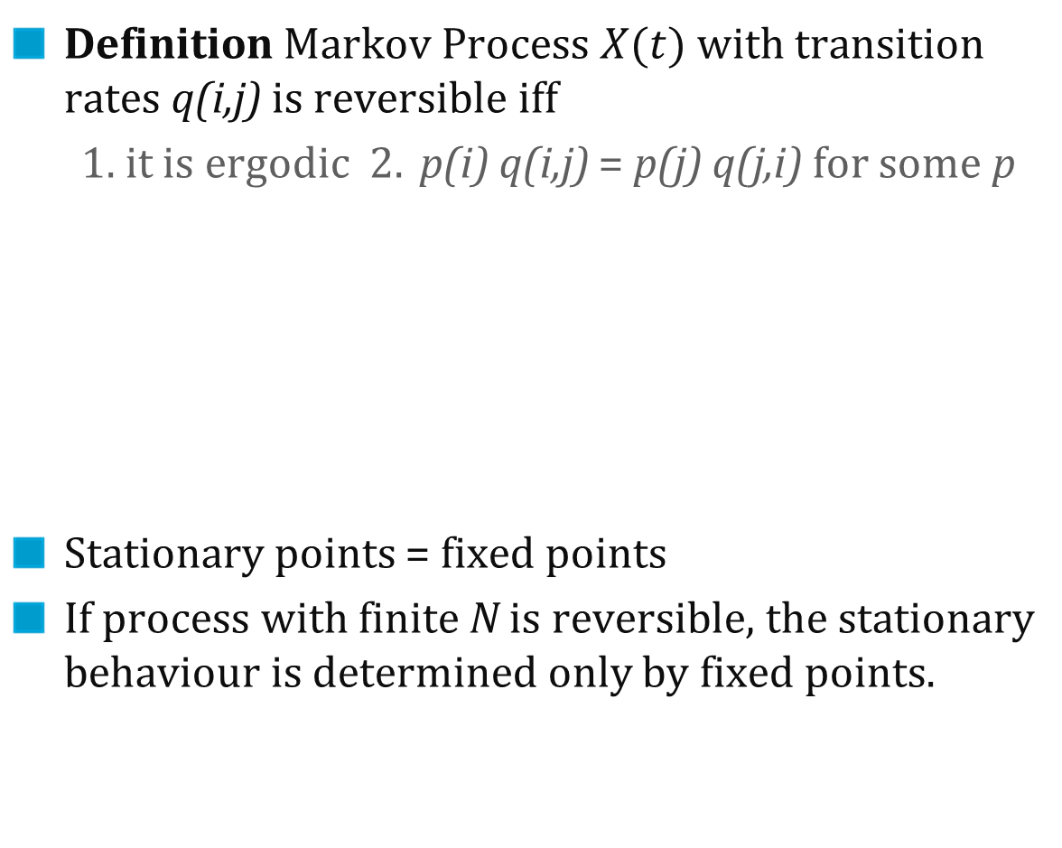
Positive Result 2: In the Reversible Case, the Fixed Point Method Always Works
Definition Markov Process $X(t)$ with transition rates q(i,j) is reversible iff
1. it is ergodic 2. p(i) q(i,j) = p(j) q(j,i) for some p
Stationary points = fixed points
If process with finite N is reversible, the stationary behaviour is determined only by fixed points.

Slide 38
A Correct Method in Order to Make the Decoupling Assumptions
1. Write dynamical system equations in transient regime
2. Study the stationary regime of dynamical system
if converges to unique stationary point m* then make fixed point assumption
else objects are coupled in stationary regime by mean field limit m(t)
Hard to predict outcome of 2 (except for reversible case)

Slide 39
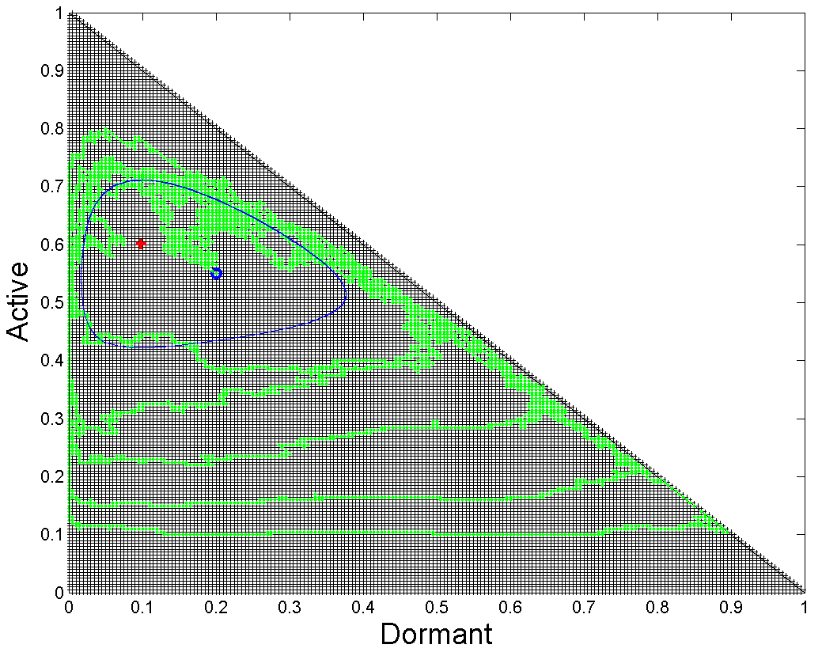
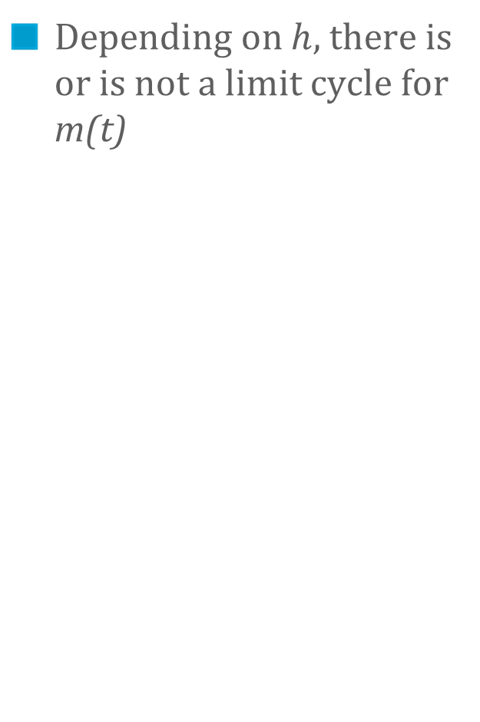
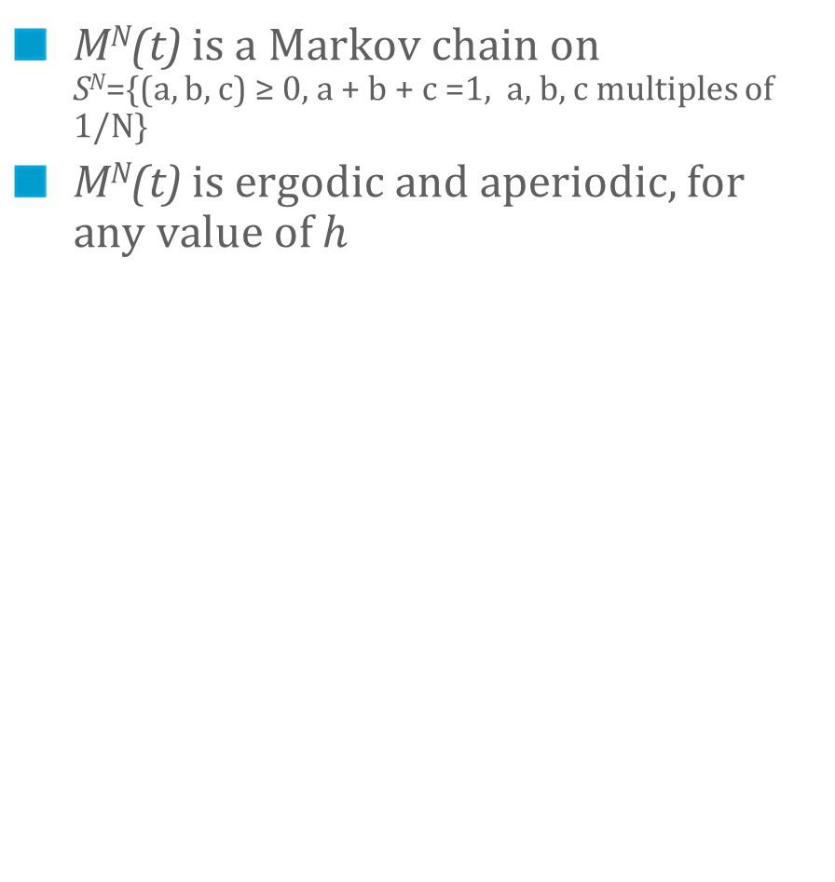
Stationary Behaviour of Mean Field Limit is not predicted by Structure of Markov Chain
M^{N}(t) is a Markov chain on S^{N}={(a, b, c) ≥ 0, a + b + c =1, a, b, c multiples of 1/N}
M^{N}(t) is ergodic and aperiodic, for any value of $h$
Depending on $h$, there is or is not a limit cycle for m(t)
S^{N} (for N = 200)
h = 0.3
h = 0.1

Slide 40
Conclusion
Mean field models are frequent in large scale systems
Validity of approach is often simple by inspection
Mean field is both
ODE for fluid limit
Fast simulation using decoupling assumption
Decoupling assumption holds at finite horizon; may not hold in stationary regime (except for reversible case)
Study the stationary regime of the ODE ! (instead of computing the stationary proba of the Markov chain)

Slide 41
Thank You …

Slide 42
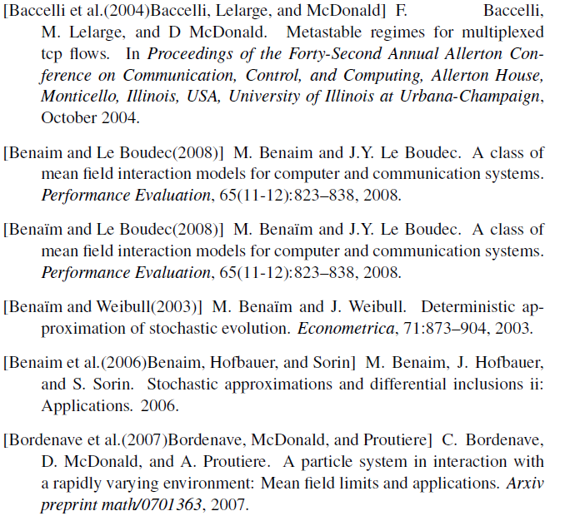
References

Slide 43
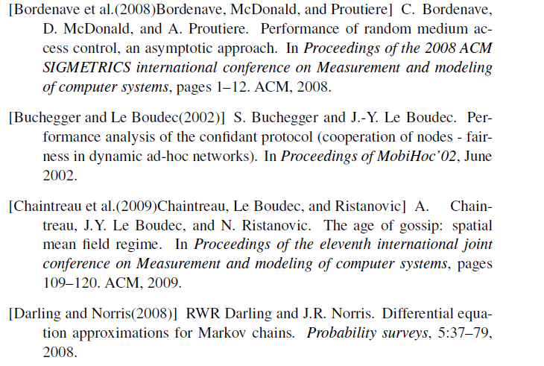
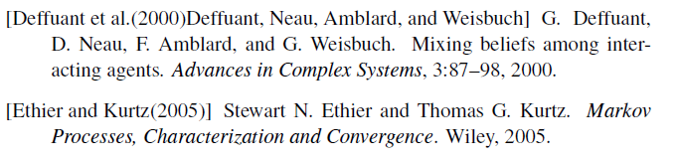

Slide 44
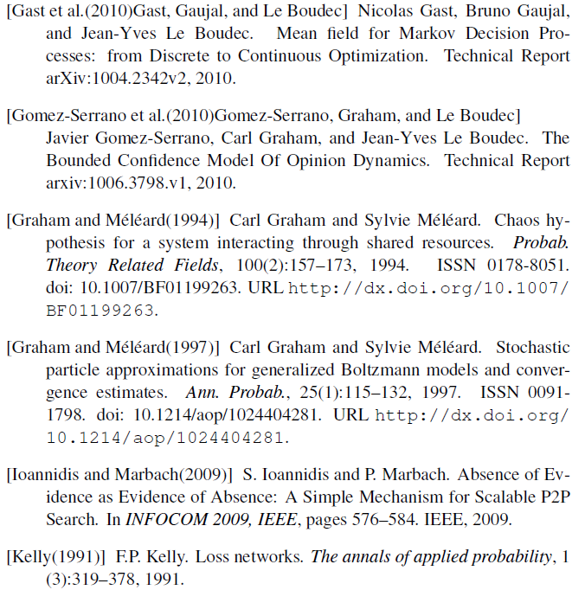
[Gomez-Serrano et al, 2012] Gomez-Serrano J., Graham C. and Le Boudec J.-Y. The Bounded Confidence Model Of Opinion Dynamics Mathematical Models and Methods in Applied Sciences, Vol. 22, Nr. 2, pp. 1150007-1--1150007-46, 2012.
2

Slide 45
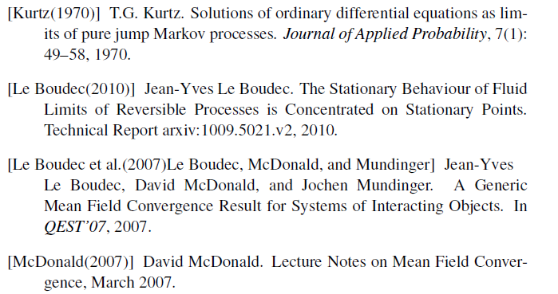
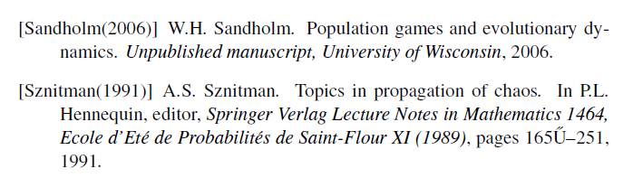

Slide 46
